Slide 1

Introduction to DB
Course 7
{Dev}School Java

Slide 2

What is a Database?
Notes:
O bază de date este o colecţie organizată de informaţii sau de date structurate, stocate electronic pe un suport extern (dispozitiv de stocare).
O bază de date este controlată, de regulă, de un sistem de management al bazelor de date (DBSM - Database Management System). Reprezintă totalitatea programelor utilizate pentru crearea, interogarea și întreținerea unei baze de date.

Slide 3
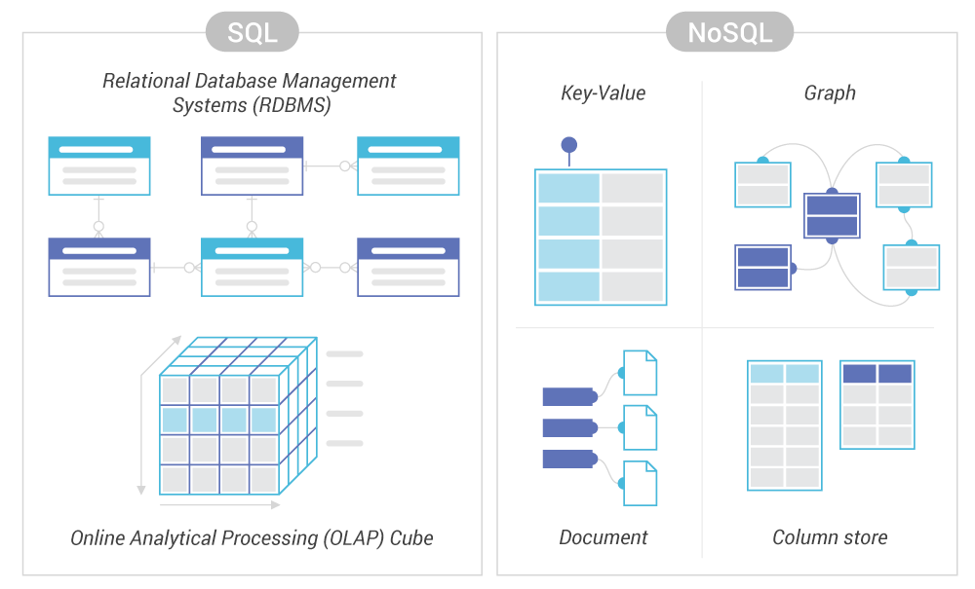
SQL-based vs NoSQL-based

Slide 4
Which Modern Database is Right for your Use Case?

Slide 5
Relational databases
Notes:
Se bazează pe:
Entități si atributele dintre ele(atributele definesc entitatile)
Relații între entități

Slide 6
Entity

Slide 7
Constraints
Notes:
Cheile reprezintă constrângeri importante ale entităților. Sunt reprezentate de un atribut sau un grup de attribute care identifică în mod unic o entitate într-o mulțime de entități.
Primary key/ Cheia primară identifică în mod unic o linie/intrare în tabelă. Nu poate avea valoare nulă.
Foreign key / Cheia străină este un atribut din tabelă care stabilește o relație între atribut și cheia primară a unei alte tabele.

Slide 8
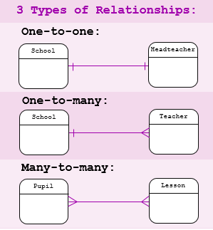
Relationships
3 types : based on the number of
associations between 2 entities

Slide 9
MySql
Most DBs use a Structured Query Language(SQL) to write or read data
It’s not case sensitive
For instance when writing select or SELECT, in both cases the code will run with success.
The statement delimiter is ; and marks the end of a statement
In order to be executed any statement must end in ;

Slide 10
Data types

Slide 11
String types
Data type | Description
CHAR(size) | A FIXED length string (can contain letters, numbers, and special characters). The size parameter specifies the column length in characters - can be from 0 to 255. Default is 1
VARCHAR(size) | A VARIABLE length string (can contain letters, numbers, and special characters). The size parameter specifies the maximum column length in characters - can be from 0 to 65535
BINARY(size) | Equal to CHAR(), but stores binary byte strings. The size parameter specifies the column length in bytes. Default is 1
VARBINARY(size) | Equal to VARCHAR(), but stores binary byte strings. The size parameter specifies the maximum column length in bytes.
TINYBLOB | For BLOBs (Binary Large OBjects). Max length: 255 bytes
TINYTEXT | Holds a string with a maximum length of 255 characters
TEXT(size) | Holds a string with a maximum length of 65,535 bytes
BLOB(size) | For BLOBs (Binary Large OBjects). Holds up to 65,535 bytes of data
MEDIUMTEXT | Holds a string with a maximum length of 16,777,215 characters
MEDIUMBLOB | For BLOBs (Binary Large OBjects). Holds up to 16,777,215 bytes of data
LONGTEXT | Holds a string with a maximum length of 4,294,967,295 characters
LONGBLOB | For BLOBs (Binary Large OBjects). Holds up to 4,294,967,295 bytes of data
ENUM(val1, val2, val3, ...) | A string object that can have only one value, chosen from a list of possible values. You can list up to 65535 values in an ENUM list. If a value is inserted that is not in the list, a blank value will be inserted. The values are sorted in the order you enter them
SET(val1, val2, val3, ...) | A string object that can have 0 or more values, chosen from a list of possible values. You can list up to 64 values in a SET list

Slide 12
Numeric data types
Data type | Description
BIT(size) | A bit-value type. The number of bits per value is specified in size. The size parameter can hold a value from 1 to 64. The default value for size is 1.
TINYINT(size) | A very small integer. Signed range is from -128 to 127. Unsigned range is from 0 to 255. The size parameter specifies the maximum display width (which is 255)
BOOL | Zero is considered as false, nonzero values are considered as true.
BOOLEAN | Equal to BOOL
SMALLINT(size) | A small integer. Signed range is from -32768 to 32767. Unsigned range is from 0 to 65535. The size parameter specifies the maximum display width (which is 255)
MEDIUMINT(size) | A medium integer. Signed range is from -8388608 to 8388607. Unsigned range is from 0 to 16777215. The size parameter specifies the maximum display width (which is 255)
INT(size) | A medium integer. Signed range is from -2147483648 to 2147483647. Unsigned range is from 0 to 4294967295. The size parameter specifies the maximum display width (which is 255)
INTEGER(size) | Equal to INT(size)
BIGINT(size) | A large integer. Signed range is from -9223372036854775808 to 9223372036854775807. Unsigned range is from 0 to 18446744073709551615. The size parameter specifies the maximum display width (which is 255)
FLOAT(size, d) | A floating point number. The total number of digits is specified in size. The number of digits after the decimal point is specified in the d parameter. This syntax is deprecated in MySQL 8.0.17, and it will be removed in future MySQL versions
FLOAT(p) | A floating point number. MySQL uses the p value to determine whether to use FLOAT or DOUBLE for the resulting data type. If p is from 0 to 24, the data type becomes FLOAT(). If p is from 25 to 53, the data type becomes DOUBLE()
DOUBLE(size, d) | A normal-size floating point number. The total number of digits is specified in size. The number of digits after the decimal point is specified in the d parameter
DOUBLE PRECISION(size, d)
DECIMAL(size, d) | An exact fixed-point number. The total number of digits is specified in size. The number of digits after the decimal point is specified in the d parameter. The maximum number for size is 65. The maximum number for d is 30. The default value for size is 10. The default value for d is 0.
DEC(size, d) | Equal to DECIMAL(size,d)

Slide 13
Date and Time Data types
Data type | Description
DATE | A date. Format: YYYY-MM-DD. The supported range is from '1000-01-01' to '9999-12-31'
DATETIME(fsp) | A date and time combination. Format: YYYY-MM-DD hh:mm:ss. The supported range is from '1000-01-01 00:00:00' to '9999-12-31 23:59:59'. Adding DEFAULT and ON UPDATE in the column definition to get automatic initialization and updating to the current date and time
TIMESTAMP(fsp) | A timestamp. TIMESTAMP values are stored as the number of seconds since the Unix epoch ('1970-01-01 00:00:00' UTC). Format: YYYY-MM-DD hh:mm:ss. The supported range is from '1970-01-01 00:00:01' UTC to '2038-01-09 03:14:07' UTC. Automatic initialization and updating to the current date and time can be specified using DEFAULT CURRENT_TIMESTAMP and ON UPDATE CURRENT_TIMESTAMP in the column definition
TIME(fsp) | A time. Format: hh:mm:ss. The supported range is from '-838:59:59' to '838:59:59'
YEAR | A year in four-digit format. Values allowed in four-digit format: 1901 to 2155, and 0000. MySQL 8.0 does not support year in two-digit format.

Slide 14
DDL & DML

Slide 15
MySQL DDL(Data Definition Language)
1. CREATE Command
2. ALTER Command
3. DROP Command
4. TRUNCATE Command

Slide 16
DML
DML is short name of Data Manipulation Language which deals with data manipulation and includes most common SQL statements such:
SELECT
INSERT
UPDATE
DELETE,
etc.,
and it is used to store, modify, retrieve, delete and update data in a database.

Slide 17

Notes:
https://learnsql.com/blog/sql-joins-types-explained/

Slide 18
Let’s create a Project Management Data Model
What entities do we need?
Team, Employee, Project what more?
What columns do they have?
What relationships are between the entities?

